Slide 1
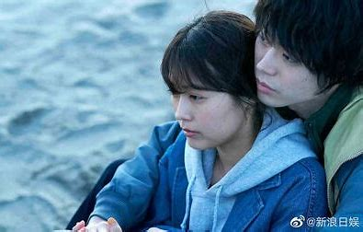

We Made a Beautiful Bouquet：
Movie analysis and emotional relationship discussion
BrainBrumish

Slide 2

01
Synopsis
02
Why did they break up？
03
What‘s A Soul Mate？
04
content
Conclusions and Applications
目录

Slide 3
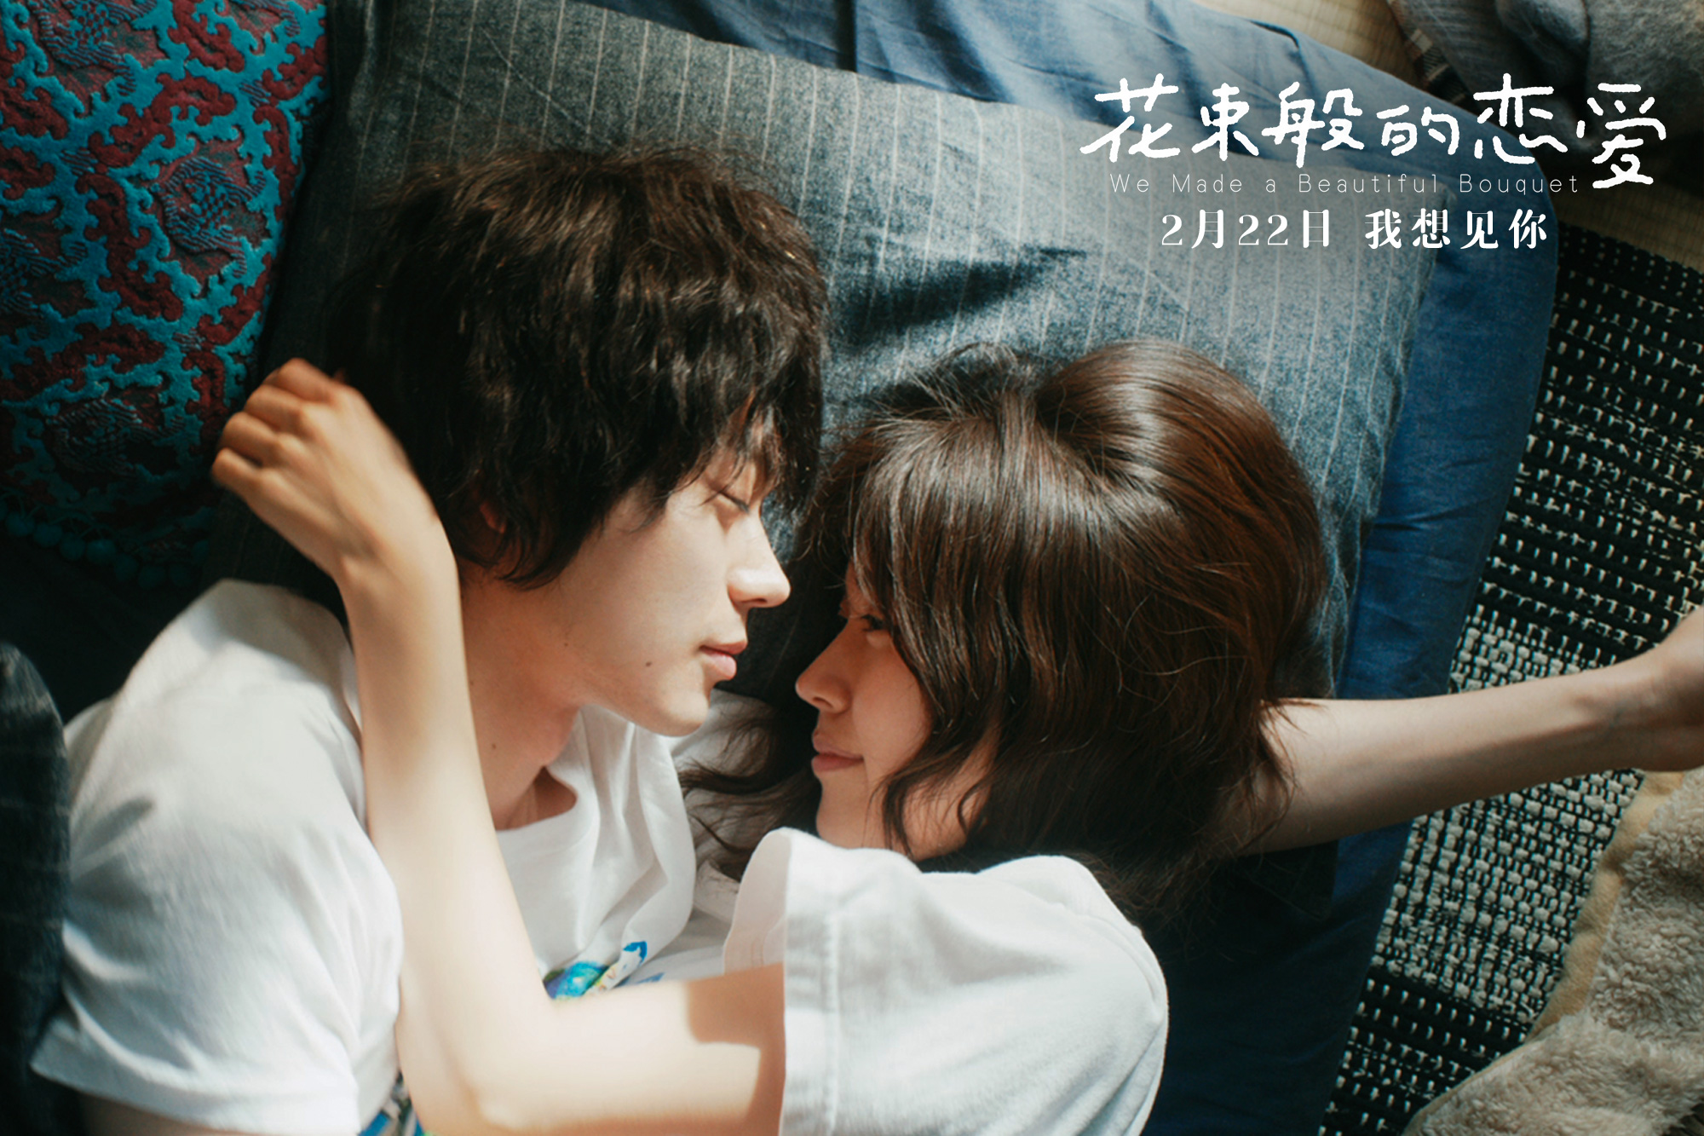
We Made a Beautiful Bouquet
01
I CRAVE THE SIGHT OF YOU

Slide 4

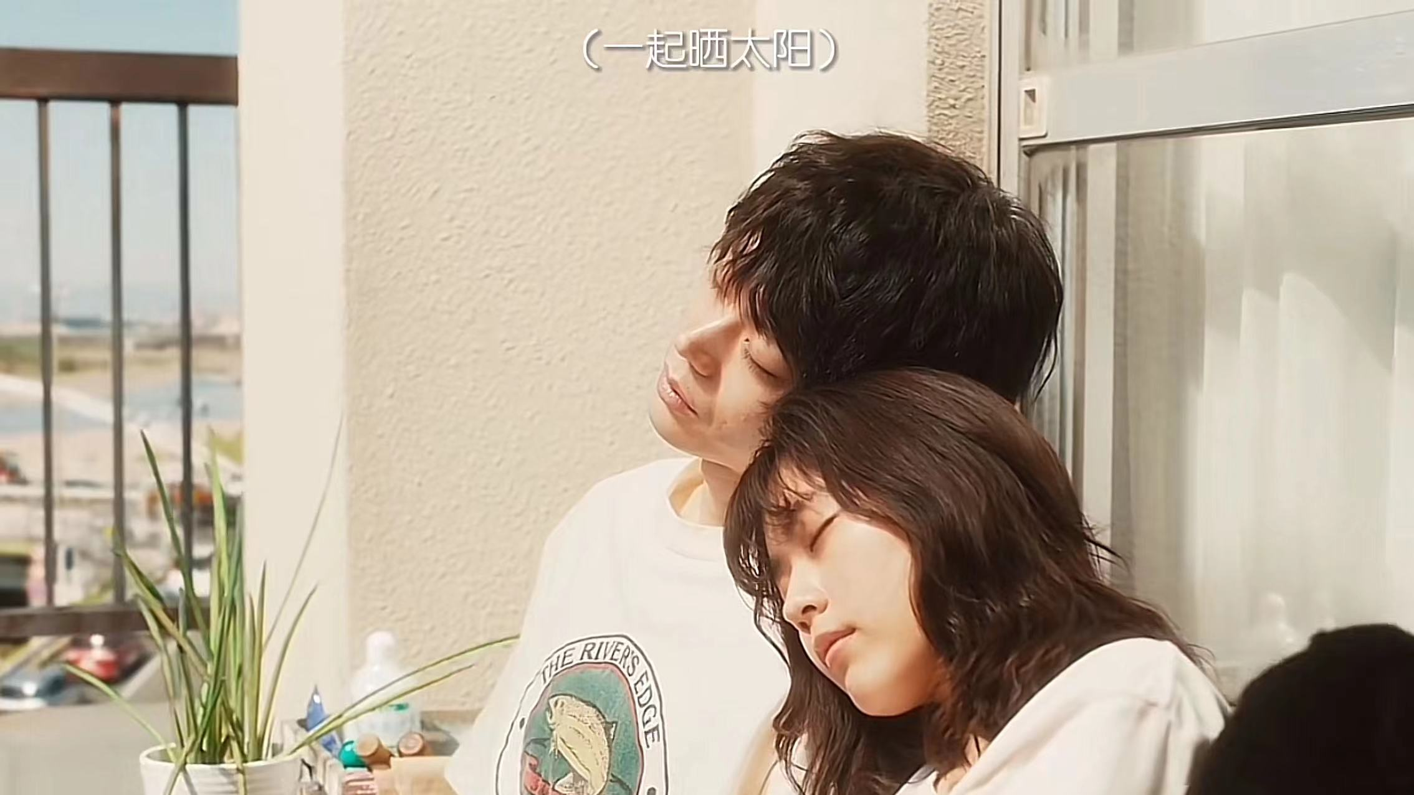
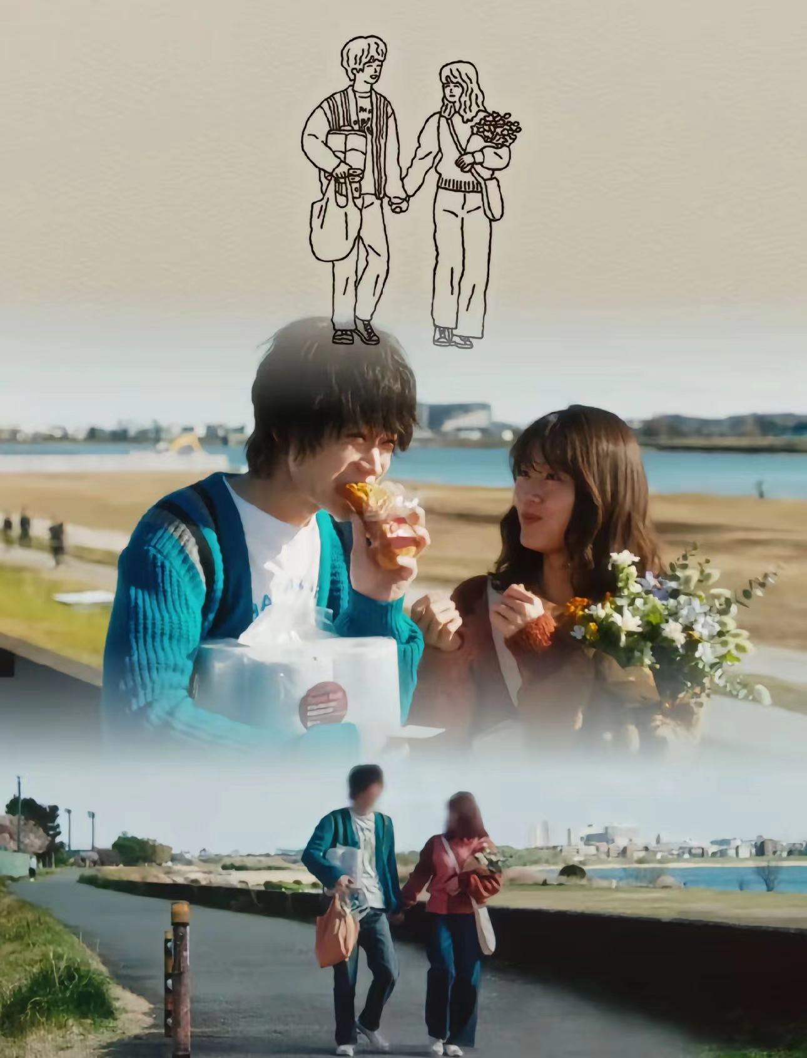
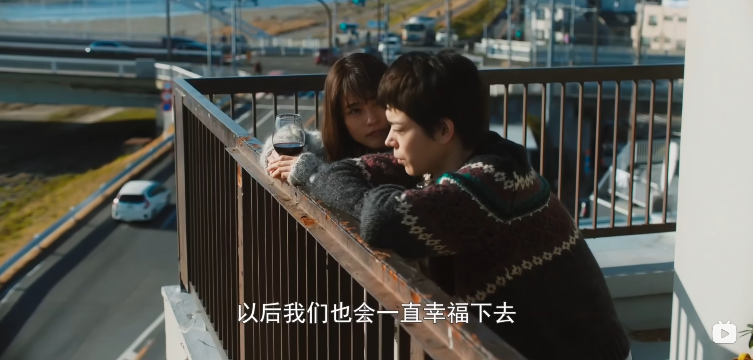
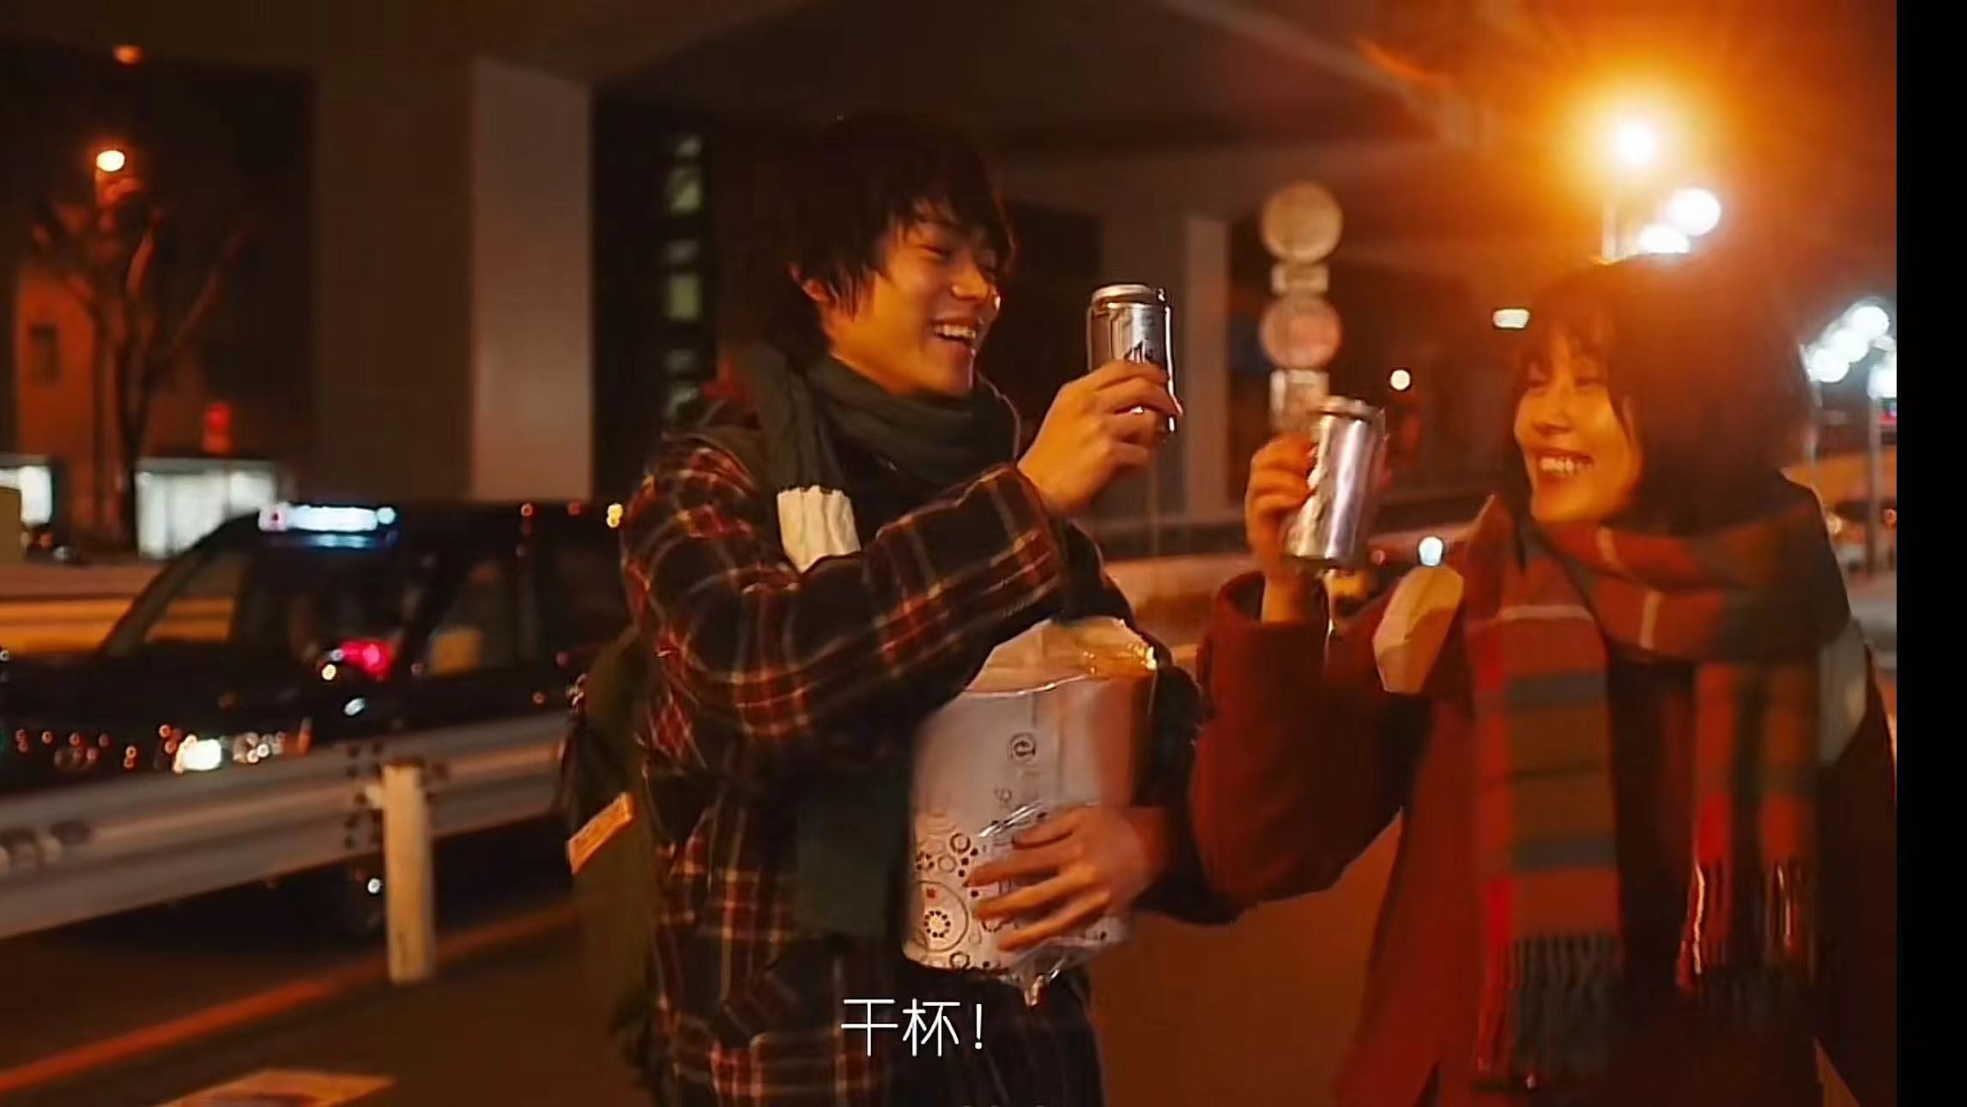
Movie Ovrview
Highlights of the film
Delicate emotional depiction, real life scenes, showing the beauty and helplessness of modern youth love。
The rose bloom has passed ,their fade now inevitable

Slide 5
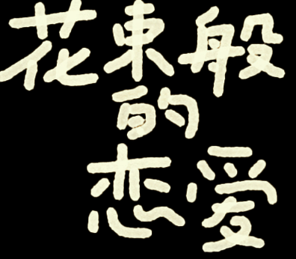
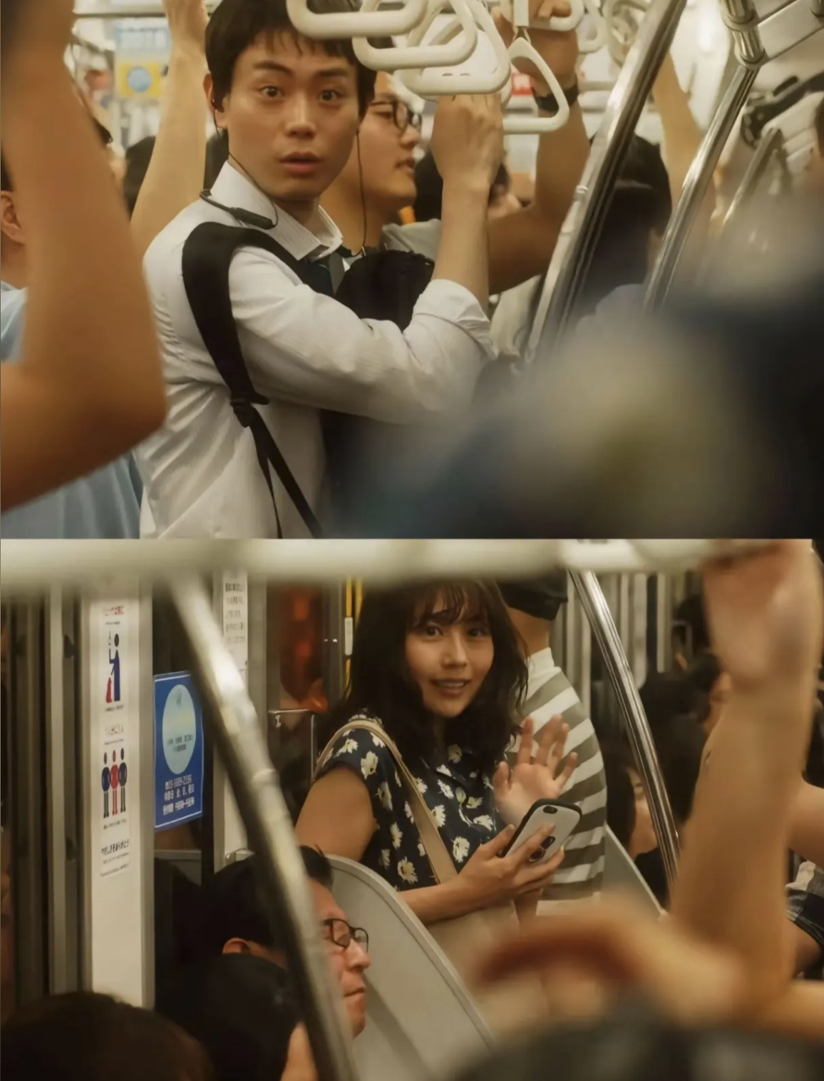
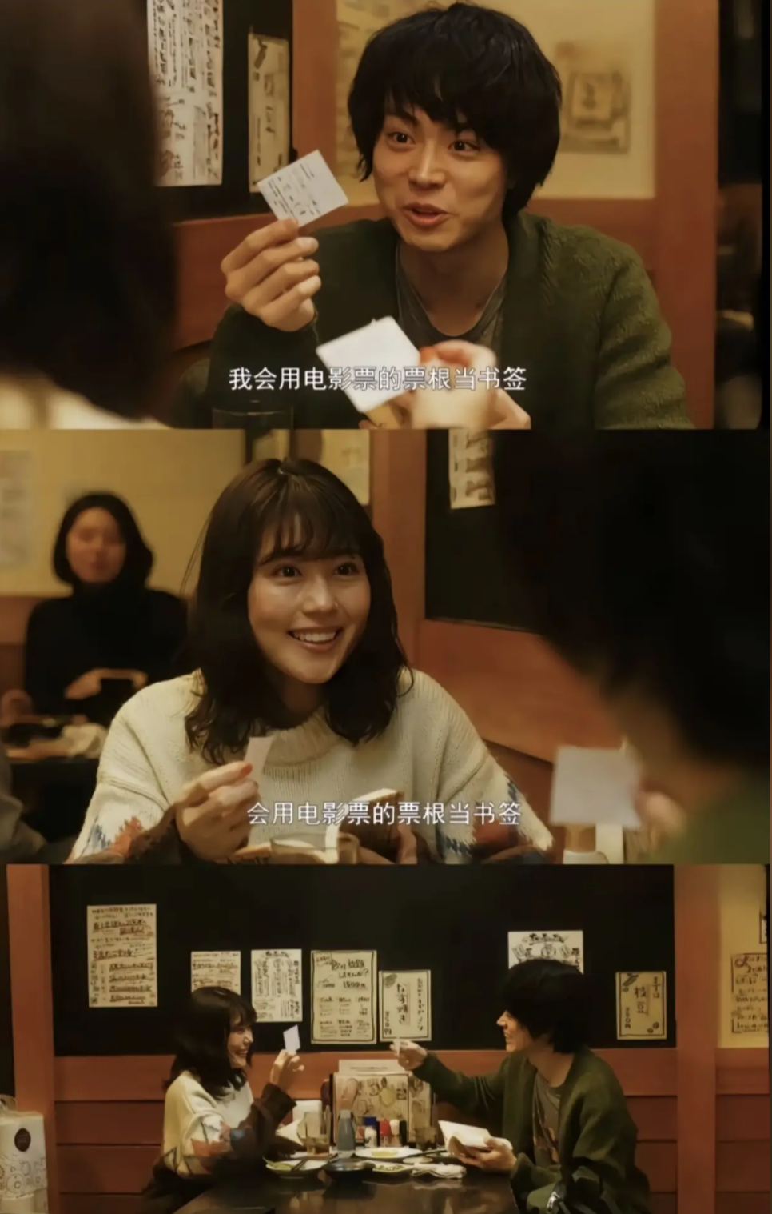
Movie Overview
Encounter Origin
Miss the chance encounter of the last train, common interests such as literature and art, quickly shorten the distance between each other.
There is such a thing as love, you can't be half of one person, love is one for one person

Slide 6
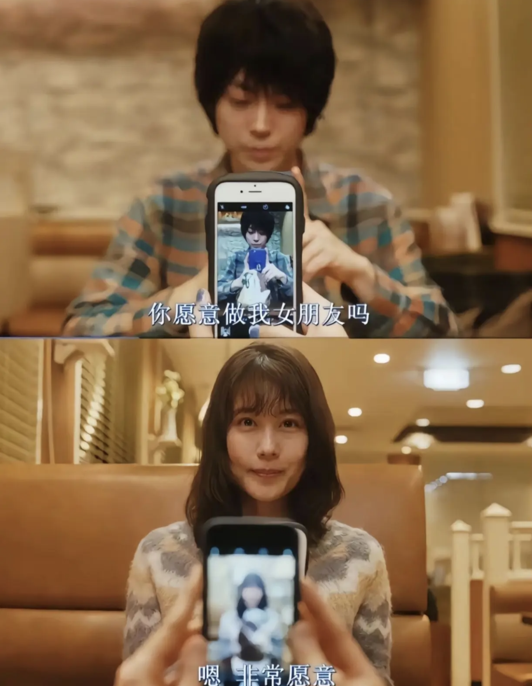
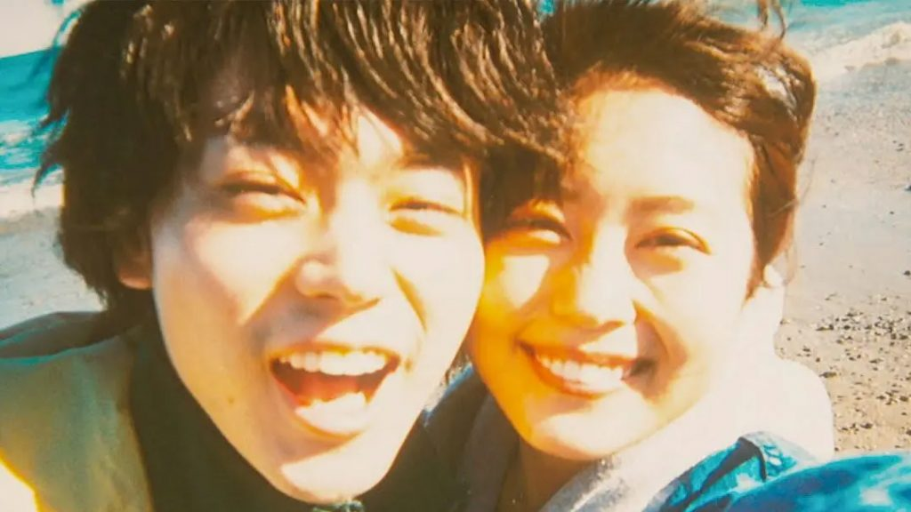
Movie Overview
Sweet relationship
Share books, movies, and music to quickly build a deep romantic connection and make the perfect love happen.
Encounters always hide parting, and love is like a party that will end one day

Slide 7
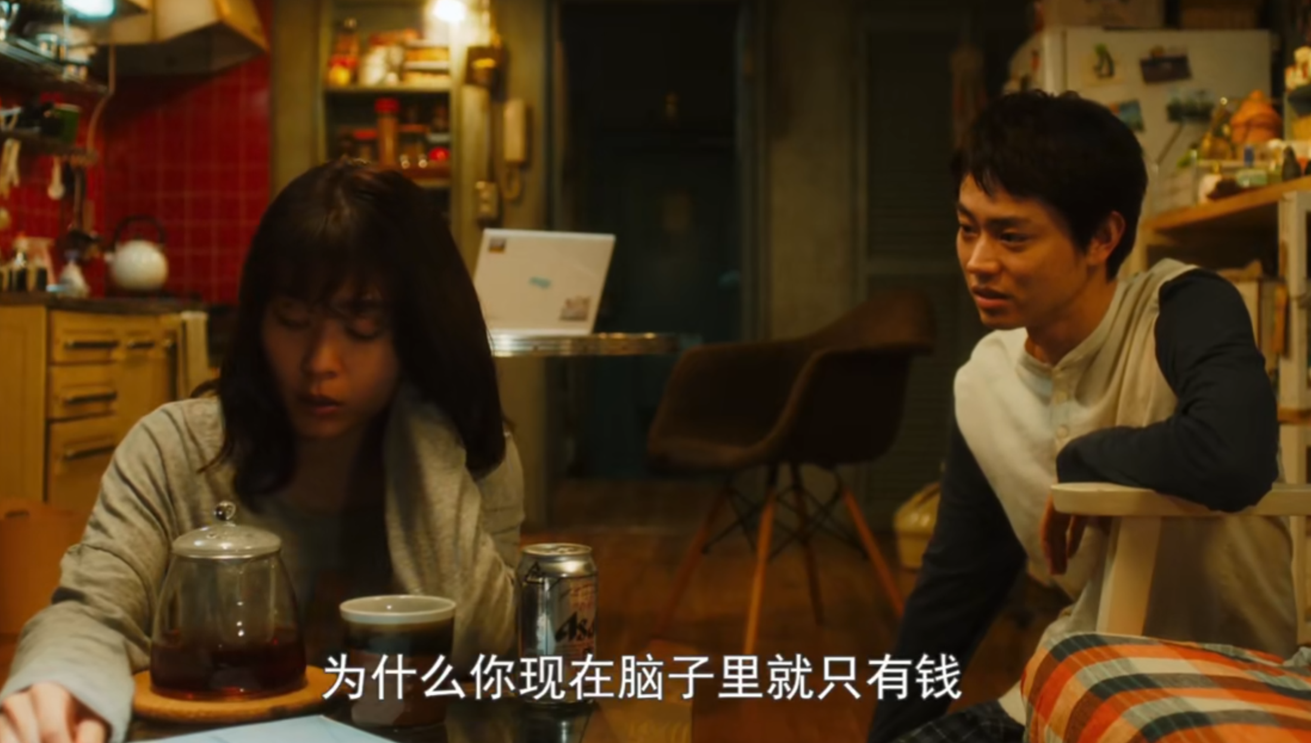
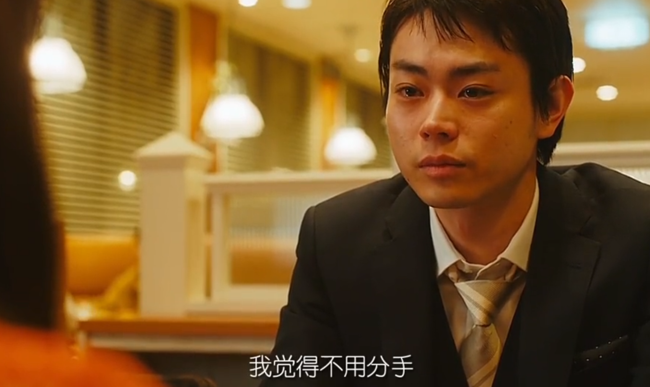
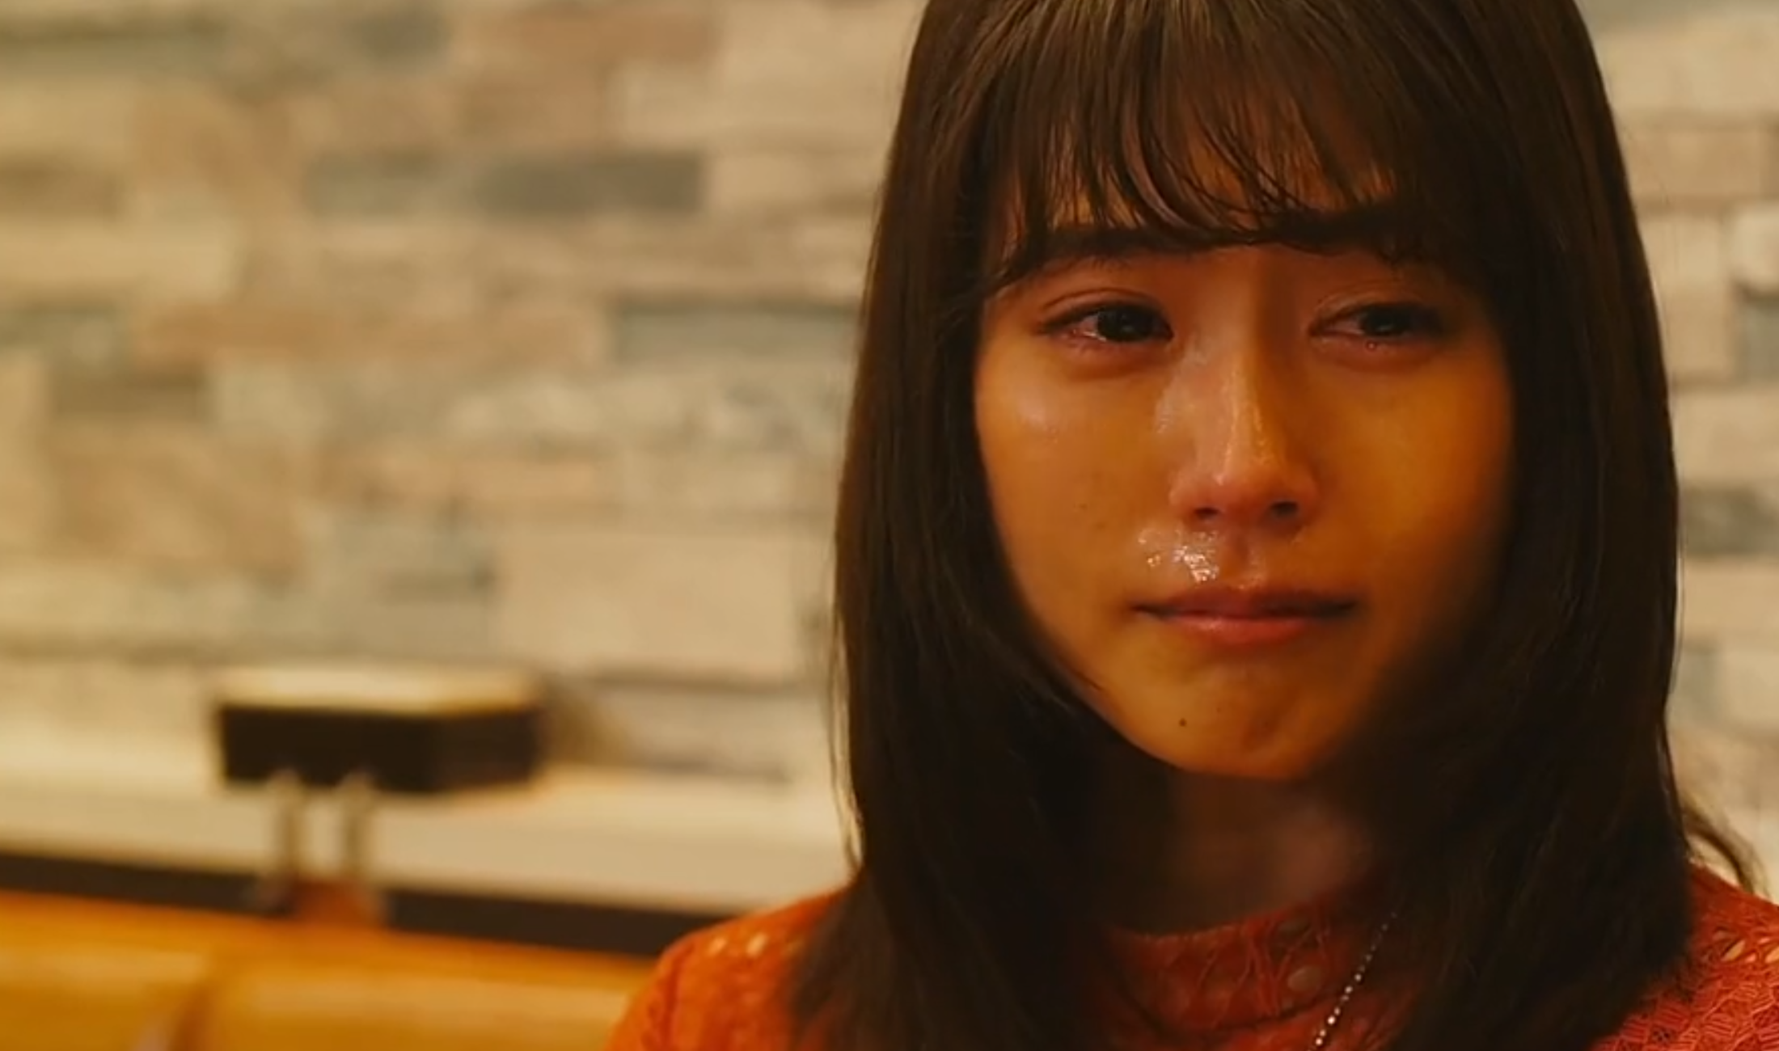
Movie Overview
Life stress
The busy work and the difference in the pace of life gradually revealed contradictions and eroded the foundation of the relationship between the two.

Slide 8
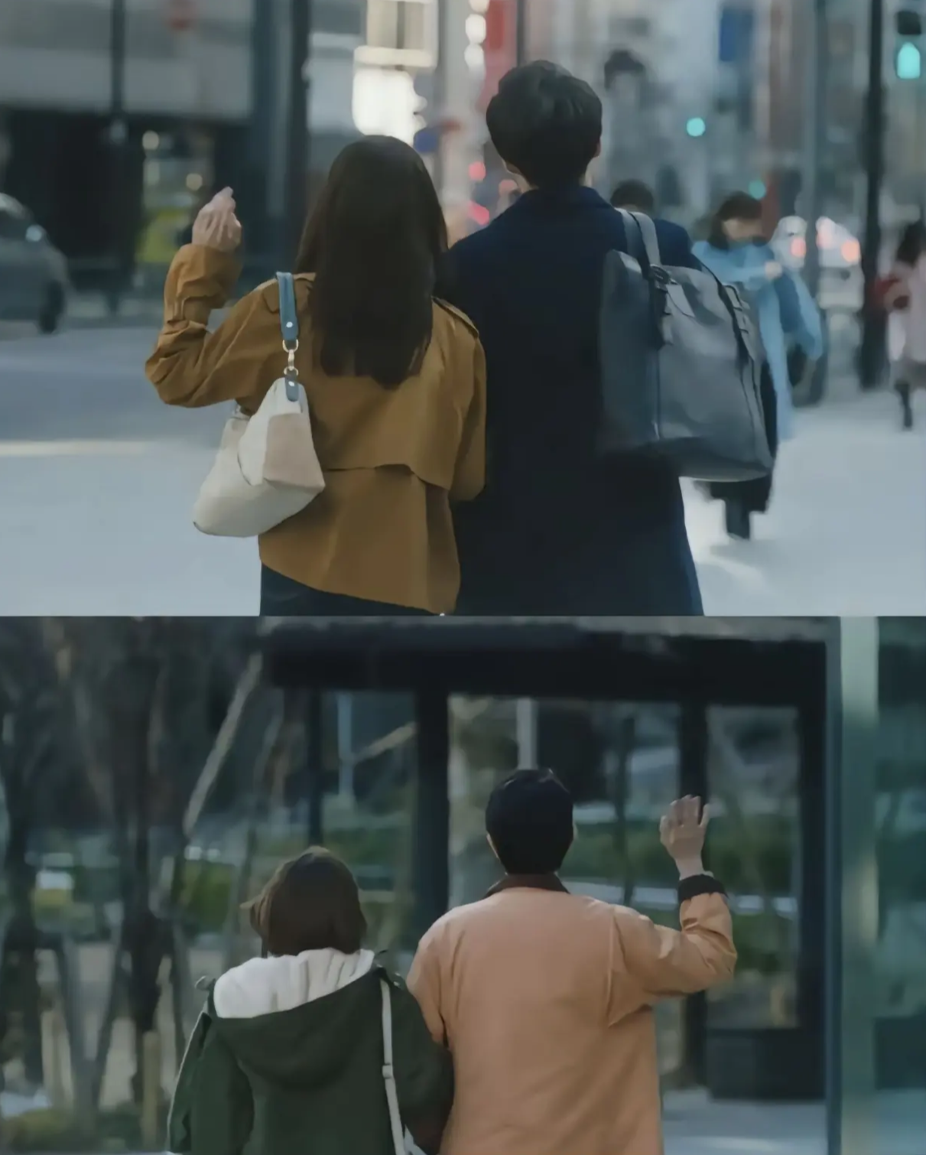
Turning point analysis
01
02
Life stresses come to the fore
The conflict between career and love
As time goes on, the realities of life begin to manifest and test the couple's love.
The male protagonist is busy with work, and his focus shifts from love to career, and he has a disagreement with the heroine.
03
04
Romance meets reality
A peaceful breakup
The heroines pursue poetry and romance, while the friction of reality gradually erodes their sweetness.
In the end, they calmly expressed their feelings at the dinner table and chose to break up, and the scene was heartbreaking.

Slide 9
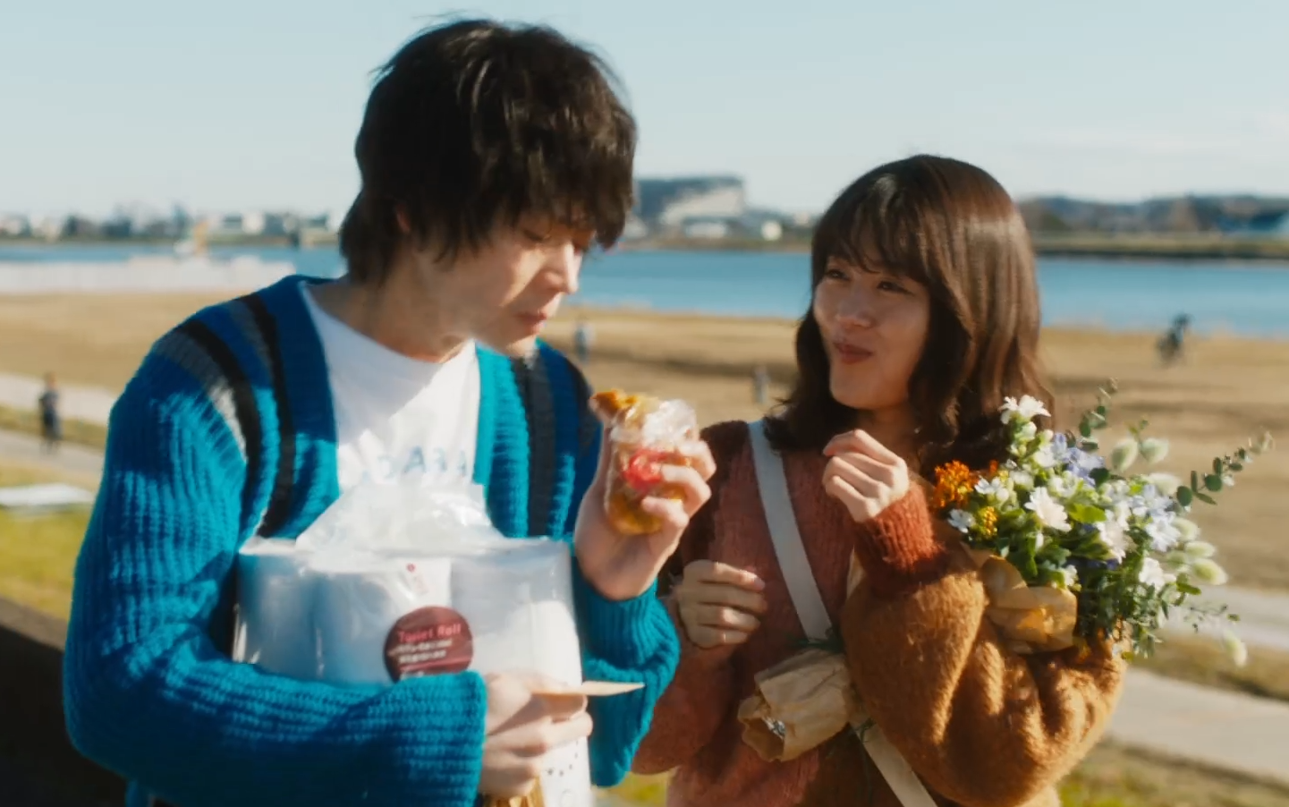
Why Did They
Break Up?
02
关系剖析：为何分手？

Slide 10
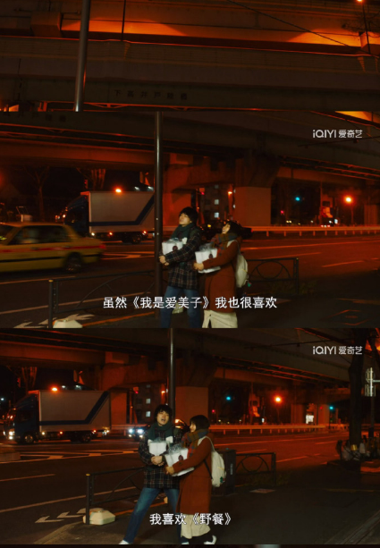
Surface Similarities
Many young relationships start with shared interests (pop music, culture, anime)
These similarities attract but stay superficial.

Slide 11
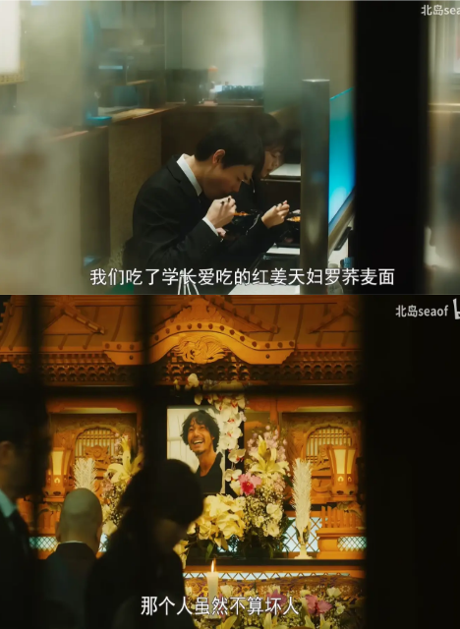
Lack of Depth
The protagonists didn't explore each other's differences deeply.
Examples:
Male likes gas cylinders.
Female enjoys mummy exhibits.
Different views on the opposite sex

Slide 12
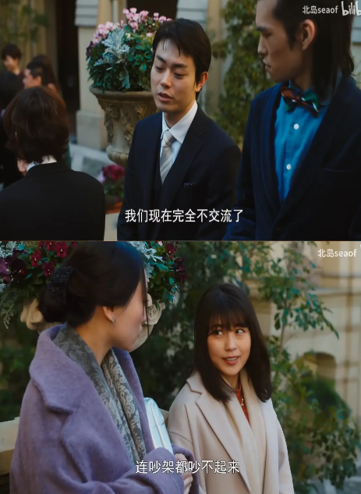
Conflict and Compromise
Different life goals and values lead to more friction and less intimacy.
Conflicting values cause the romance to fade.

Slide 13
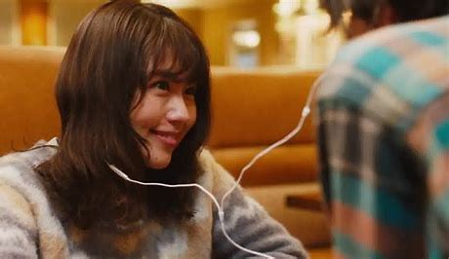
03
What's A Soul Mate ？
Is the main character in the movie a soul mate?

Slide 14
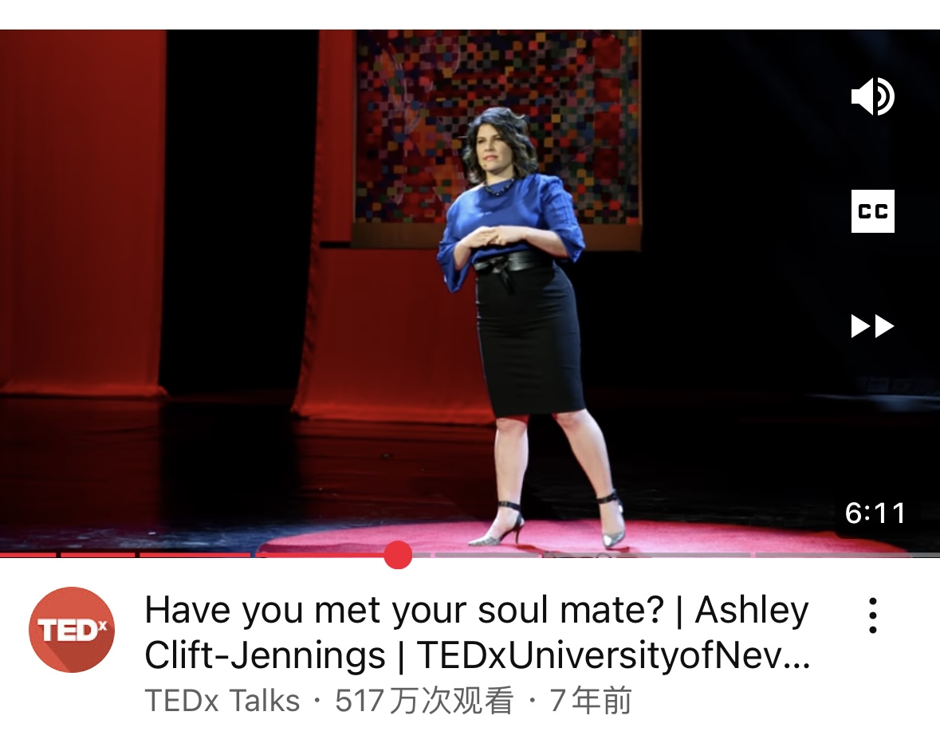
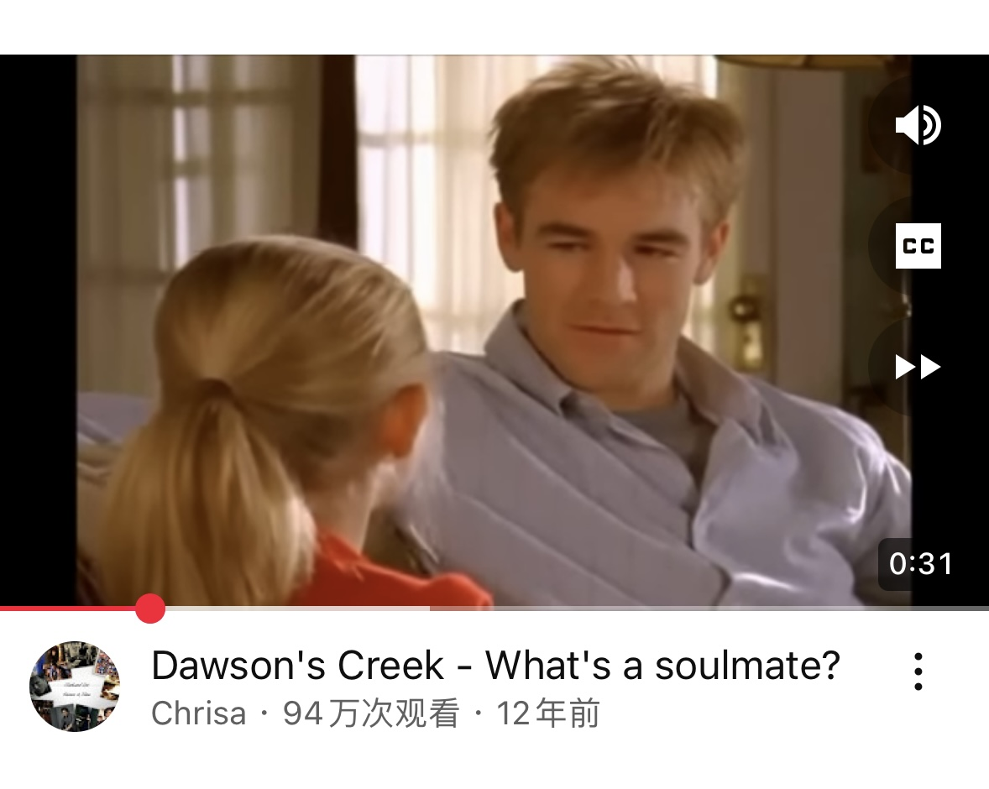
What people think about soulmates...
“He was like the yin to my yang.And it just worked like lock and key,just so seamless.We just really enjoy each other's minds. And it felt like the most peaceful time in my entire life.I felt like I had a home inside this person's soul.This person lived with me,we worked together,ofentimes we do projects together,we dreamed together...“
"It's like a best friend but more.It's the one person in the world who knows you than anyone else.It's someone who makes you a better person.Actually they don't make you a better person.You do that yourself.Because they inspire you."

Slide 15

Consistency in the outlook of world,life and values
True Soul Mates share a similar worldview ,and understand and respect each other's philosophy of life.
A similar outlook on life enables two people to understand, support and accompany each other as they face the ups and downs of life, major decisions and trivial matters in daily life, bring each other comfort and strength to move forward.
The pursuit of similar values is a connection in the depths of the soul, transcending superficial interests and touching the fundamental pursuit of life.

Slide 16
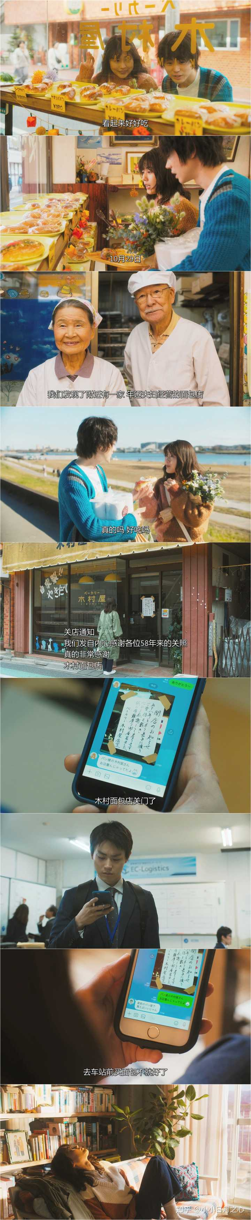
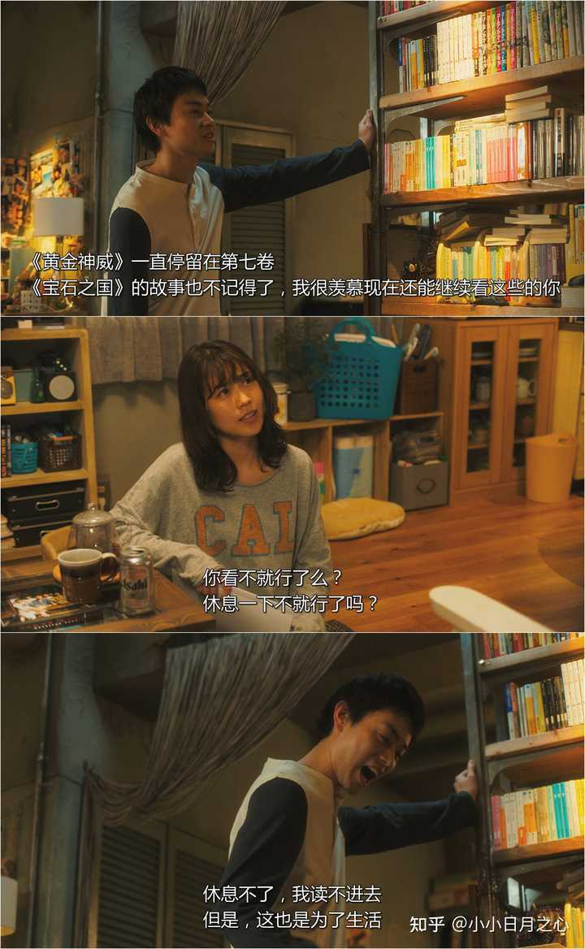
The understanding and
proper handling of the differences
A soul mate understand and respect each other's deep thoughts.They grows together and deepen the relationship in the face of disagreements.
A true soul mate can reach deep into each other's hearts and at the same time face trivial and major challenges in life together.

Slide 17
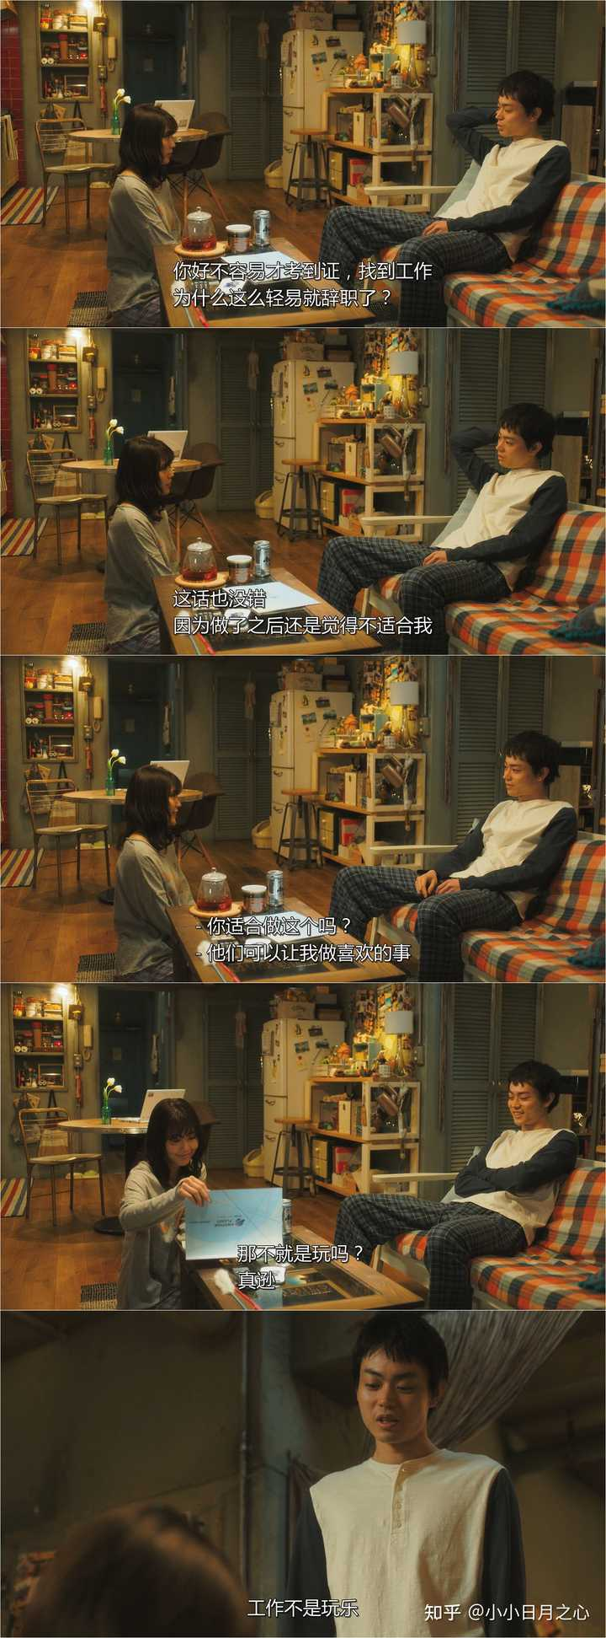
Having tremendous amout of respect for one another and literally make each other a better people
01
A pair of soul mate work like lock and key,
and they enjoy each others minds.
02
It's someone who makes you a better person.Because they inspire you.
It's the one person who know you,and believe you before anyone else did and when no one else would.

Slide 18
Conclusion
Having tremendous amout of respect for one another and literally make each other a better people
Connsistency in the outlook of world,life and values
The understanding and
proper handling of the differences
The three stages of becoming a soulmate are closely related, progressive, and indispensable.
Approaches in common,surpasses in differences.

Slide 19
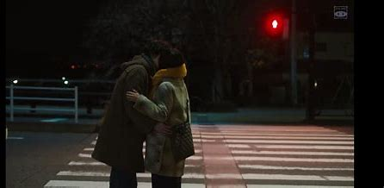
04
Conclusions
and Applications

Slide 20
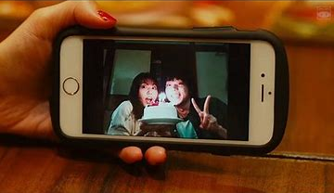
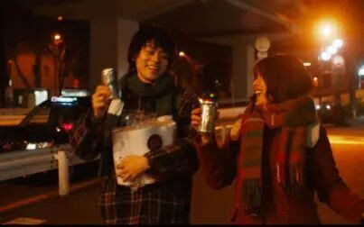
Review
They have lots of similarities...
Superficial Aspects
----that looked the the same
BUT...
DEEPLY SEPERATED MINDS
BUT...
HEAD-ON BLOW given by
DIFFERENCES

Slide 21
What in essence caused
-- and how to improve relationship?
01
02
03 e.g.
Common Purpose
Integrating tight without being fragile
Aruguments and fights are thorough-faced meaningless
共同目标
让关系更加紧密而非岌岌可危
争吵与打架是毫无意义的，并不能
解决问题

Slide 22
未来展望
Find true self
Create a better future
Wise love
Encourage everyone to explore themselves, understand and cherish their core values and beliefs, and prepare them to meet their true soul mates.
Advocate partners to create a better future together, through effective communication and goal alignment, face life challenges, work together, and build a stable and deep emotional foundation.
Advocate a wise view of love, realize that love is not only passion and romance, but also need to tolerate differences and work together to make love stronger in the test of reality.

Slide 23
PURPOSE 目的
添加标题
添加标题
REASON 原因
MANIFESTATION 行为
添加标题
MOOD 情绪
添加标题

Slide 24
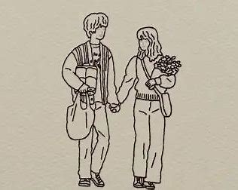
THANKS
BrainBrumish

